Slide 1
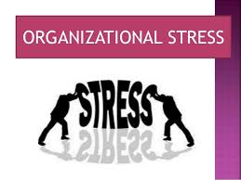
From shaikh kausar class : fybms sub : foundation of human skills unit 4
Organizational stress

Slide 2
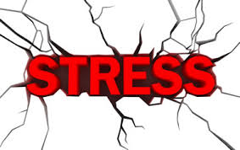
Definition :- Stress may be defined as a state of psychological and or physiological imbalance resulting from the disparity between situational demand and the individual’s ability and or motivation to meet those demands.

Slide 3
DEFINITION OF ORGANIZATIONAL STRESS
Organizational stress is commonly defined as an emotional, cognitive behavioural and physiological response to the aggressive and harmful aspects of work, work environment and organizational climate.

Slide 4
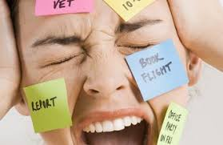

Slide 5
The nature of stress
Stress and Job Performance:
Stress can be constructive or destructive:
As stress increases performance also improves as the individual gathers resources to meet the new requirement . Thus stress is constructive in nature.
Too much stress leads to tension , anxiety and low performance. The person is unable to make
decisions . And if the stress level increases the performance becomes zero. There Stress becomes destructive in nature when the level of stress becomes excessive.

Slide 6
Stress vulnerability
Stress threshold: stress threshold is the level of stress that the person can tolerate before negative feelings about stress occurs and has an adverse effect on performance.
Perceived control : The way one thinks is the way one feels ,Employees who have independence , autonomy and freedom to make decisions in their work place are able to handle stress better. How a person perceives at the situation and what he thinks about it will determine whether an individual will experience stress or not.

Slide 7
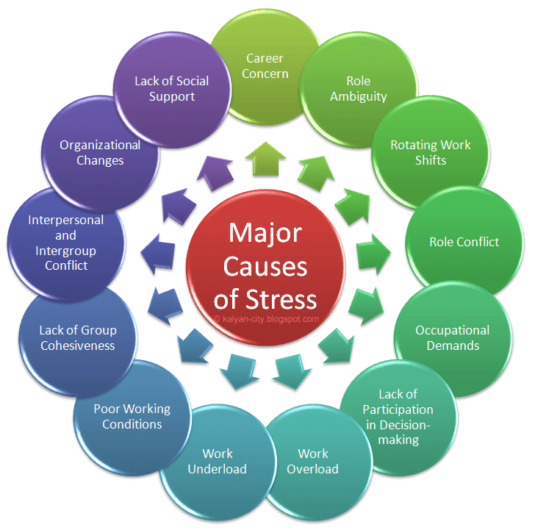
CAUSES OF STRESS

Slide 8
Stress Tools
Management Standards Providing Guidance on How to Prevent Work-related Stressors
Workload
Job Insecurity
Team working
Performance feedback
Training & development
Hours of work
Job design
Management support
Tools and equipment
Communication
Work-life balance
Effort-reward imbalance

Slide 10
An Organizational Approach to Managing Workplace Stress
Being Proactive: An Organizational Approach to Managing Workplace Stress
“ Creating a healthy and safe workplace requires employers and employees to work systematically together to identify hazards and manage them”
Stress an integral and inevitable feature of most contemporary workplaces
Workplace stress arises when individuals perceive an imbalance between the pressures and demands made on them and the resources they have to cope .

Slide 11
Managing Stress in the Workplace
Traditional view
Stress the responsibility of the individual
Organizational view
Employers and employees have a responsibility to address work-related stress

Slide 12
Stress management
It is the amelioration of stress and especially chronic stress often for the purpose of improving everyday functioning.
Stress produces numerous symptoms which vary according to persons, situations, and severity. These can include physical health decline as well as depression

Slide 13
Causes of stress management
Whenever our body feels something not favorable, then it tries to defend itself. If this situation continues for a long time, then our body is working overtime.
There are several causes of stress. For example, you are under stress when you are worried about something, worried about your children, worried about the illness of your father, worried about your job security, or worried about your loans or similar things.

Slide 14
Causes of work stress
To meet out the demands of the job.
Your relationship with colleagues.
To control staff under you.
To train your staff and take work from them.
Support you receive from your boss, colleagues and juniors.
Excessive work pressure.
To meet out deadlines.
To give new results.
To produce new publications if you are in research area.
Working overtime and on holidays

Slide 15
Other causes of stress
Fear, intermittent or continuous.
Threats: physical threats, social threats, financial threat, other threats.
Uncertainty.
Lack of sleep.
Somebody misunderstands you.
Setback to your position in society

Slide 16
Stress management at work place
There is no doubt that stress is one on of the leading factors in illness and absenteeism among employees. Besides lowering a person's immune response, stress makes us want to avoid whatever is causing it. If there is stress at work, workers who feel mildly off will feel even worse and resist coming to work. This costs many hours of productivity, lost on stress-caused illnesses and absenteeism.

Slide 17
A workplace that supports stress management through workplace wellness programs not only helps their employees to handle pressure better and stay healthier during times of stress, it also sends a message that their company cares about them. This provides emotional support as well as physical support for fighting the effects of stress

Slide 18
Business advantages of stress management:
B Less absenteeism due to stress-related disorders
L Less worker's compensation loss due to stress-related illness or accidents a Improved job performance
L Less stressful, more efficient workplace
I Improved employee attitude
I Improved employee overall health

Slide 19
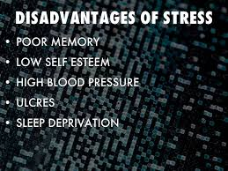

Slide 20
Disadvantages of stress
Stress can be a motivator. For example, if you’re stressed out because you have a big assignment due, this may motivate you to work on it and complete it. The stress can help you to put in your very best effort. If you're afraid of losing your job, stress may encourage you to raise your own standards and make improvements you most likely would not have made without the threat of unemployment.

Slide 21
While we all experience stress frequently in our daily lives, not everyone handles it in positive ways. The key for us all is to learn what strategies and behaviors help us to cope with stress in a positive manner.
Stress is a disadvantage because it can potentially raise your heart rate and weaken your immune system. Also, it can be a factor in poor decision making because under stress we may not think logically or consider the consequences of the choices we make.

Slide 22
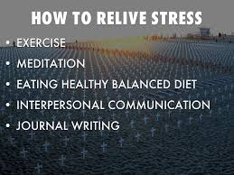

Slide 23
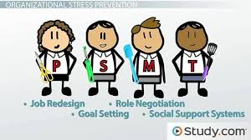

Slide 24
From : kausar shaikh
Thank you

